Slide 1

Creating Text from images with OCR API
Presented By
Karthik Prabu Natarajan (1564587)
Examined By
Prof. Dr. Damir Dobric
Prof. Dr. Andreas Pech

Slide 2
Agenda
2. Key Features
3. Building Blocks of the model
4. Design Principles of Ensemble Technique
6. Performance and Analysis
7. Testing and Visualisation
8. Conclusion
1. Objective
9. Future Work
5. Comparison metrics

Slide 3
1. Objective
Develop a C# console application utilizing the Tesseract SDK to preprocess images and perform OCR text extraction.
Evaluate and compare the effectiveness of various preprocessing techniques, providing a detailed output of the text extraction quality.

Slide 4
2. Key Features
Multi-Engine OCR Integration: Support for multiple OCR engines (Tesseract OCR, IronOCR, Google Cloud Vision)
Advanced Preprocessing Pipeline: Configurable image preprocessing techniques (binarization, deskew, noise reduction, contrast enhancement)
Text Similarity Analysis: Comprehensive evaluation using cosine and Levenshtein similarity metrics
Performance Visualization: Excel-based heatmaps and charts for intuitive representation of OCR performance
Embedding Analysis: Vector representation of OCR results for detailed text similarity analysis
Ensemble OCR texts for Synthetic Ground Truth: Innovative approach combining multiple preprocessing techniques to generate high-quality reference text
Cross-Platform Interface: Built with Avalonia UI framework for Windows and macOS compatibility

Slide 5
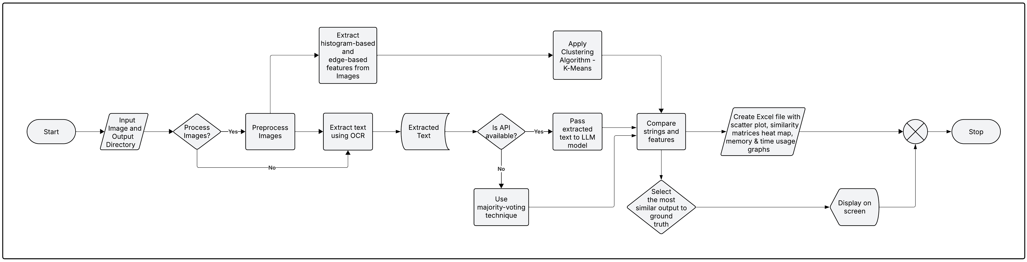
3. Building Blocks of the Application
Figure. 3.1: Workflow of the Application

Slide 6
3. Building Blocks of the Application
System Architecture
OCR Engine: Processes input images and extracts text with multiple engine support
Similarity Analysis Module: Implements text similarity metrics to evaluate OCR quality
Visualization Module: Generates Excel-based heatmaps and charts for performance visualization
Ensemble OCR System:
Uses multiple preprocessing techniques on each image
Combines OCR outputs using LLM via API calls or majority voting algorithm
Produces synthetic ground truth without manual transcription

Slide 7
3. Building Blocks of the Application
Core Algorithms
Cosine Similarity: Measures semantic similarity between word frequency vectors
Levenshtein Similarity: Calculates character-level edit distance between texts
Embedding Generation: Converts text into vector representations for visualization and comparison
Majority Voting: Combines multiple OCR results to generate accurate reference text
Clustering Analysis: Groups preprocessing methods based on features for specific preprocessing types

Slide 8
4. Design Principles of Ensemble Technique
Fallback Mechanism: Enhanced majority voting algorithm
Text normalization (standardizing whitespace, removing special characters)
Length filtering (removing very short OCR results)
Line-by-line processing (identifying most common version)
Word-level frequency analysis (selecting most common words)
Text reconstruction (recombining selected words and lines)
Ensemble OCR for Synthetic Ground Truth
Primary Approach: LLM-based text merging via API calls
Sends all OCR results to specialized endpoint
Leverages advanced language models to analyse and merge results
Applies linguistic knowledge to correct errors
Produces coherent and accurate text output

Slide 9
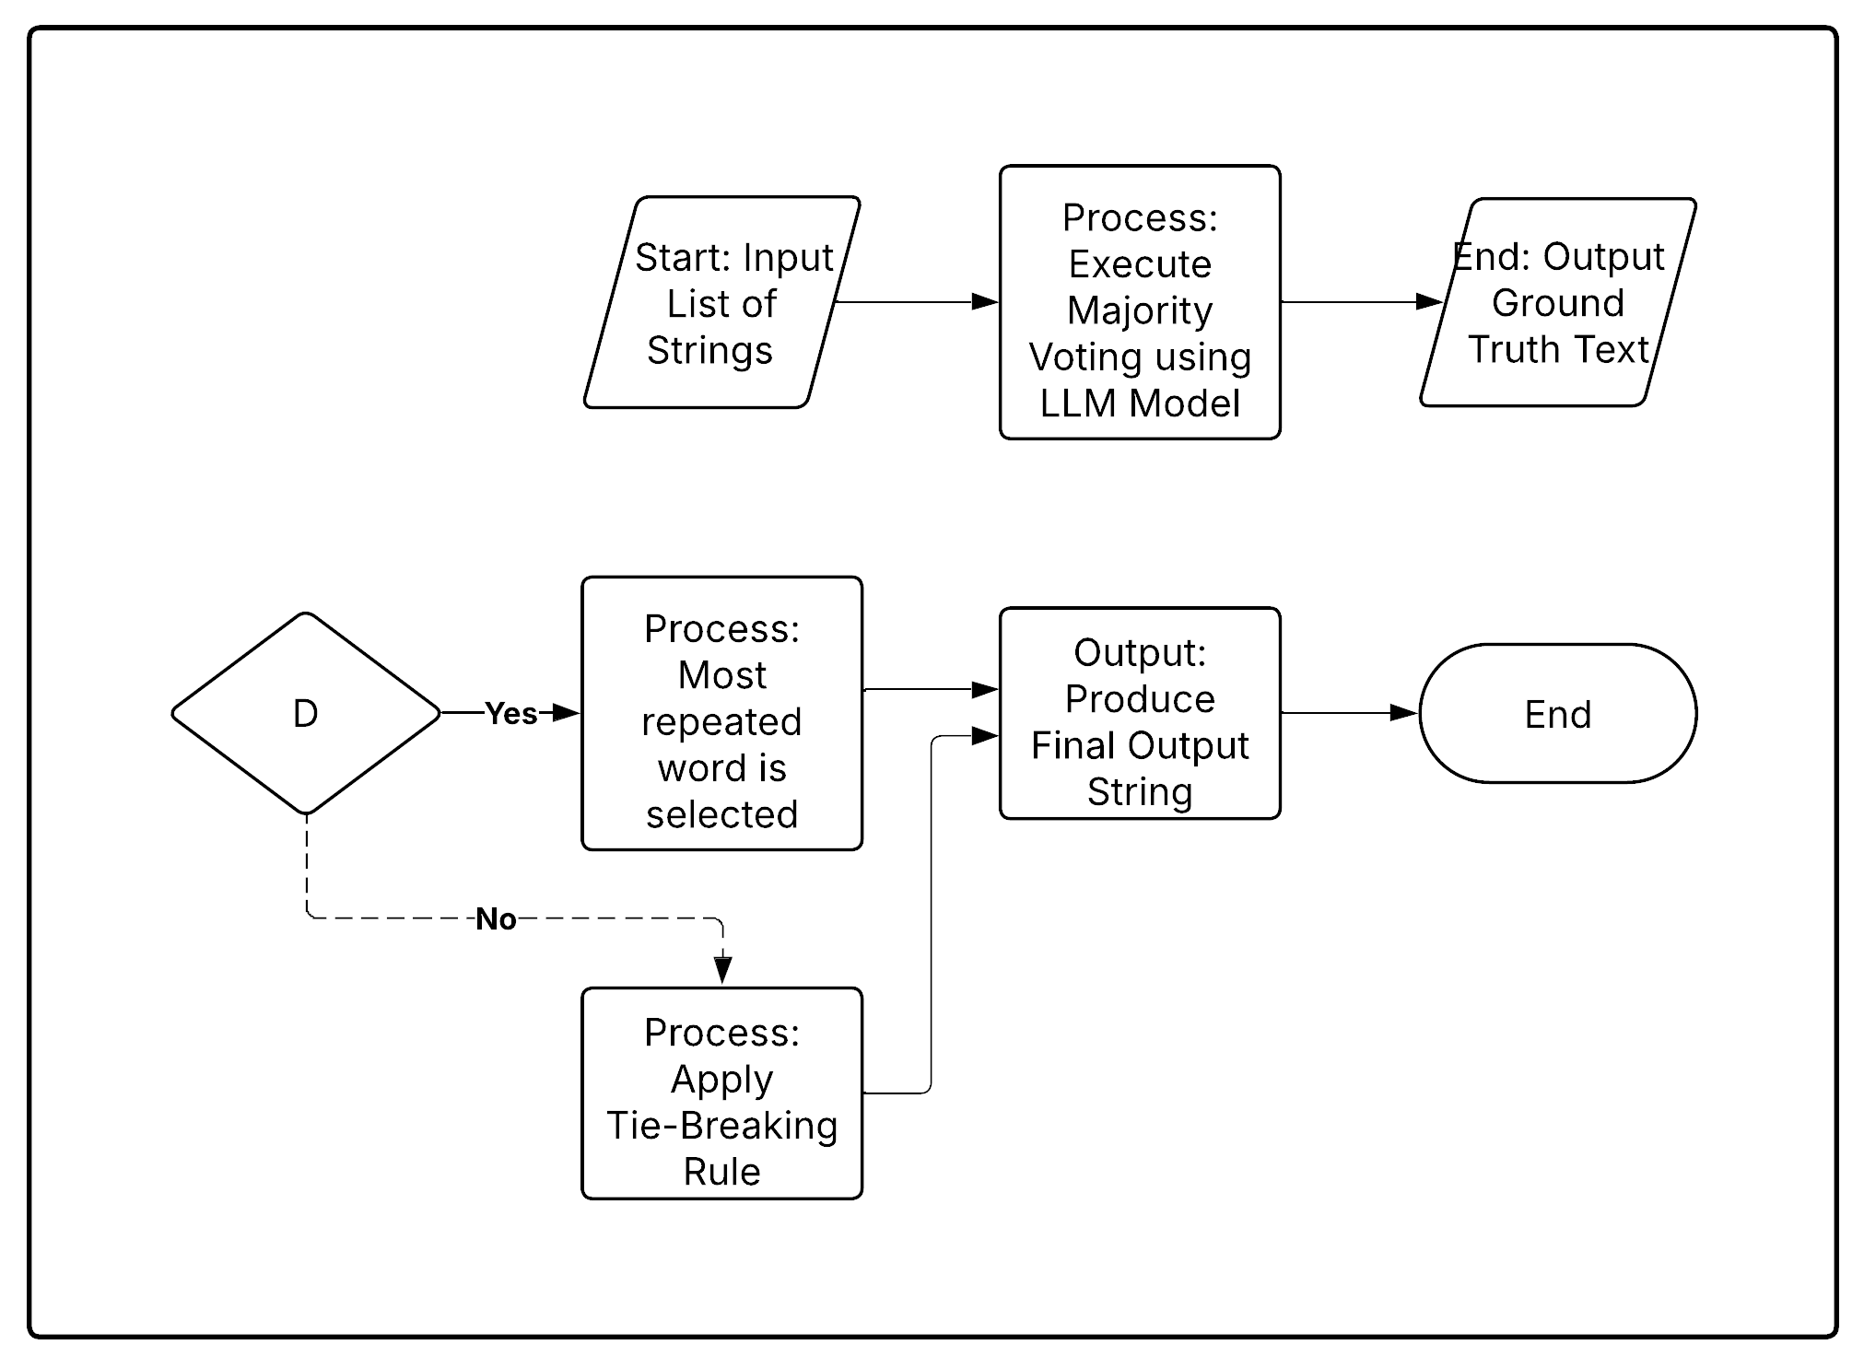
4. Design Principles of Ensemble Technique
Process Overview
This ensemble method uses majority voting to determine the most accurate text output from multiple inputs, ensuring better reliability and accuracy.
Workflow:
Input List of Strings - Multiple text outputs are collected from different models or sources.
Majority Voting using LLM - The system identifies the most frequently occurring words or phrases.
Decision Point (D): Check for Majority Agreement
Yes: If a word/phrase has the highest frequency, select it.
No: If there's a tie, apply a predefined tie-breaking rule.
Apply Tie-Breaking Rule (If Necessary) - Resolve conflicts using heuristic rules.
Produce Final Output String - The most agreed-upon text is selected.
Output Ground Truth Text – The final result is considered the best available truth (synthetic ground truth).
Figure. 4.1: Workflow of Ensemble Technique

Slide 10
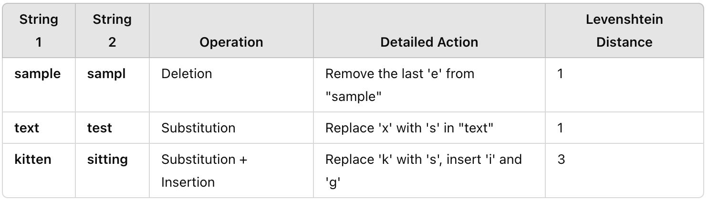
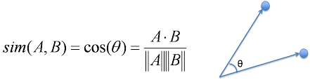
5. Comparison Techniques Employed
1. Cosine Similarity (Vector-Based Comparison)
Cosine similarity measures the angle between two text vectors, determining how similar they are regardless of magnitude.
How It Works:
Convert text into numerical vectors (e.g., TF-IDF, word embeddings).
Compute the cosine of the angle between two vectors.
A score close to 1 means high similarity, while a score near 0 means low similarity.
Example:
"cat" and "dog" might have a lower cosine similarity than "cat" and "kitten."
2. Levenshtein Distance (Edit Distance Comparison)
Levenshtein distance counts the minimum number of insertions, deletions, or substitutions needed to convert one string into another.
How It Works:
Compare text character by character.
Compute the edit distance between two words.
A smaller number indicates greater similarity.
Example:
"sample" → "sampl" (1 deletion, distance = 1)
"text" → "test" (1 substitution, distance = 1)
Visualization: A table showing the character-level transformation steps.

Slide 11
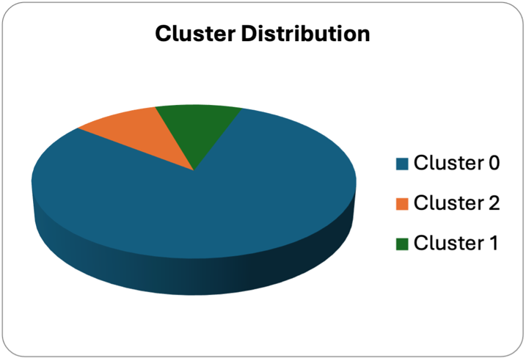
5. Comparison Techniques Employed
3. Cluster Analysis
K-Means is used to group similar features from images into clusters for improvements.
How It Works:
Extract different features from pre-processed images
Apply K-Means* clustering to group similar features
Helps identify the best preprocessing techniques by grouping related variations.
Cluster 1 typically contains methods that preserve more original image characteristics
Cluster 2 often groups methods with enhanced contrast and edge definition
Cluster 3 frequently contains the most aggressive preprocessing techniques
*K-means clustering is a method that groups similar items together based on their characteristics (histogram, edge and structural features such as brightness and contrast of image). It works by finding the best way to organize the items into a set number of groups (called clusters) so that items in the same group are more alike than those in different groups.

Slide 12
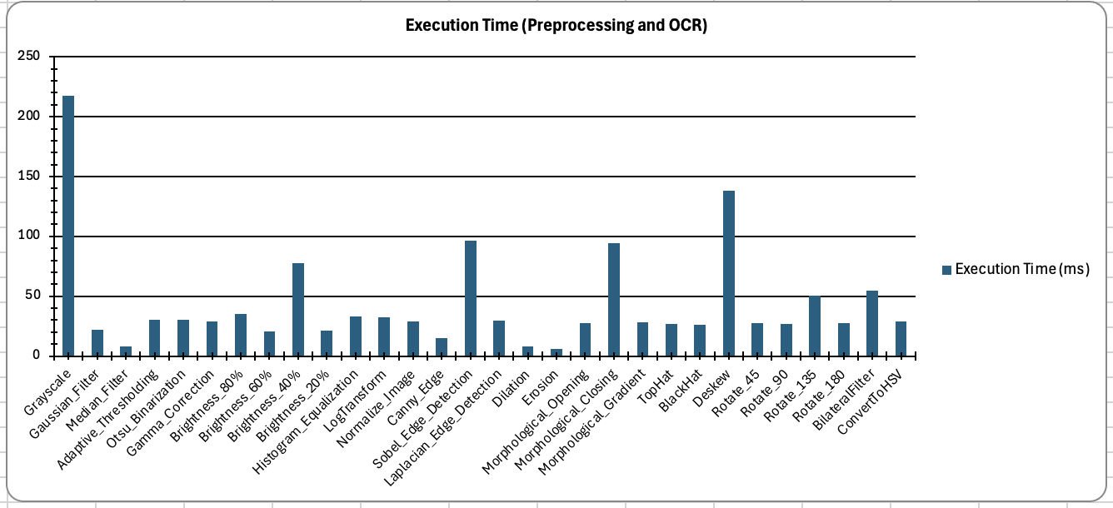
6. Performance and Analysis
Based on the analysis of multiple images, the average time required for the preprocessing method is comparatively less (approx. 50ms) for a single method applied to a single image.
Grayscale conversion technique typically takes the maximum time (over 150ms) in most cases.
Figure. 6.1: OCR Preprocessing Time

Slide 13
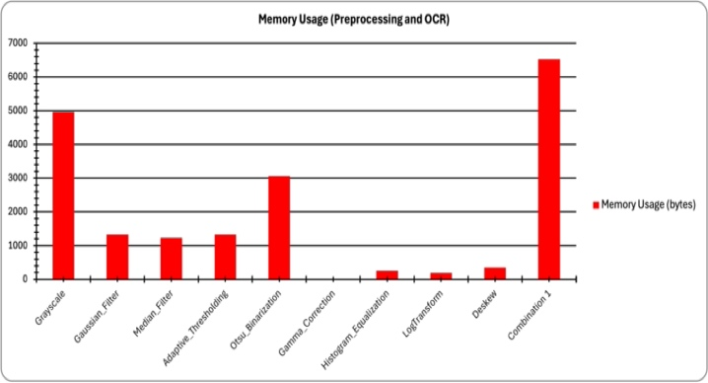
6. Performance and Analysis
The more complex transformational techniques require increased memory consumption as shown in. the Figure.
Additionally, grayscale conversion was found to use more memory in 85% of the cases.
Figure. 6.1: Image Pre-processing Memory Usages

Slide 14
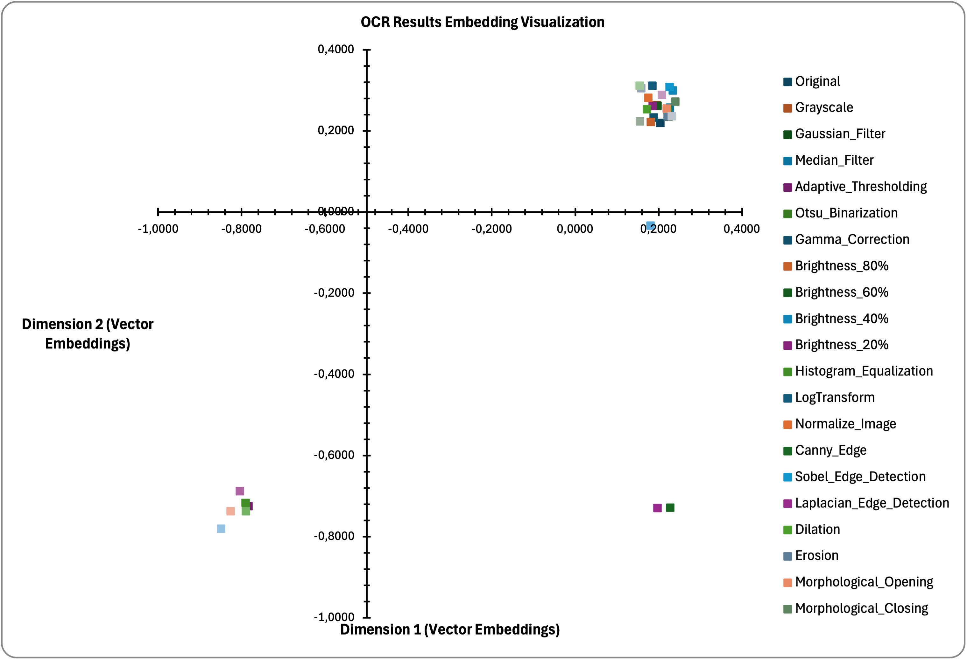
6. Performance and Analysis
The overlapping points indicate that the text from the pre-processed images is highly like each other. In contrast, the outliers—points farther from the rest—represent texts that are less similar.
Dimension 1 (text embeddings) and Dimension 2 (text embeddings) represent the vector points of the extracted text embeddings plotted on the XY plane.
This visualization helps us understand the similarity of the extracted texts in terms of their structural features.
Figure. 6.2: Scattering Plot indicating vector embeddings in 2D Plane

Slide 15
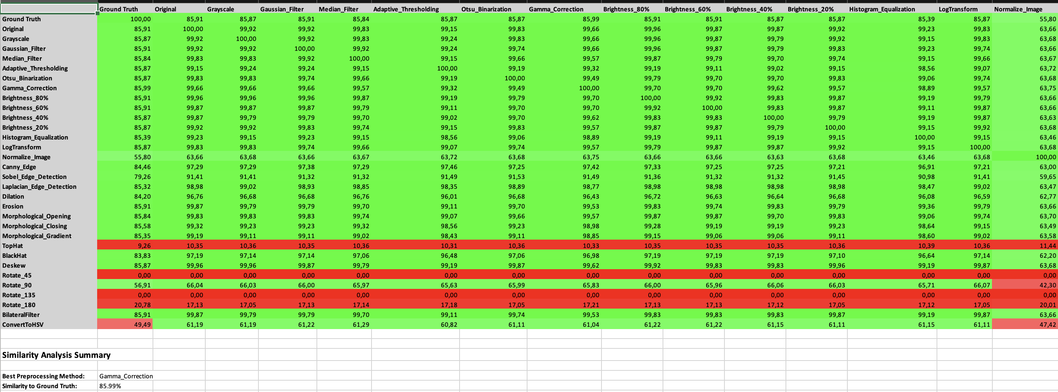
6. Performance and Analysis
Cosine Similarity measures how similar two things are by comparing the angle between them, with smaller angles indicating greater similarity.
Figure. 6.3: Cosine Similarity Matrix
The word similarity analysis using the cosine similarity method, as indicated by the similarity report, shows that grayscale and gamma correction (brightness and contrast) techniques produce more significant results compared to other techniques, with accuracy exceeding 86% and 77%, respectively.

Slide 16
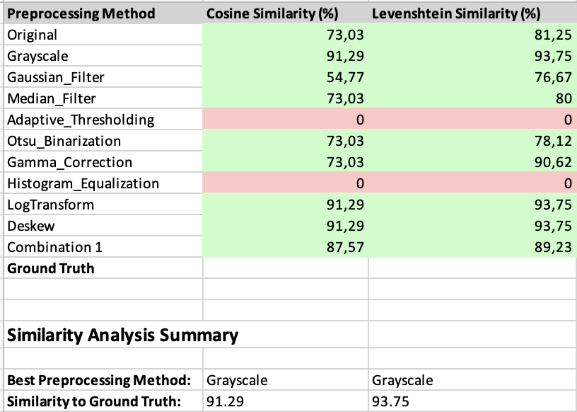
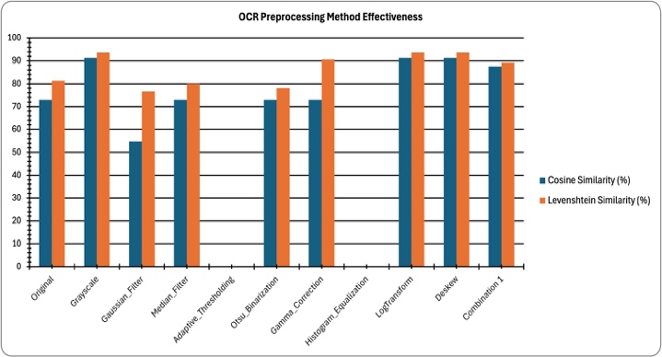
6. Performance and Analysis
The similarity report provides an overview of the comparison of the extracted text to the synthetic ground truth text.
Here both cosine similarity and Levenstein distance is calculated to and displayed and both methods selects same method as best pre-processing method
Cosine Similarity measures how similar two things are by comparing the angle between them, with smaller angles indicating greater similarity.
Levenshtein Distance counts how many changes (additions, deletions, or substitutions) are needed to turn one word into another.
Figure. 6.4: Consolidated Similarity Report
Figure. 6.4: Graph representing the consolidated Report

Slide 17
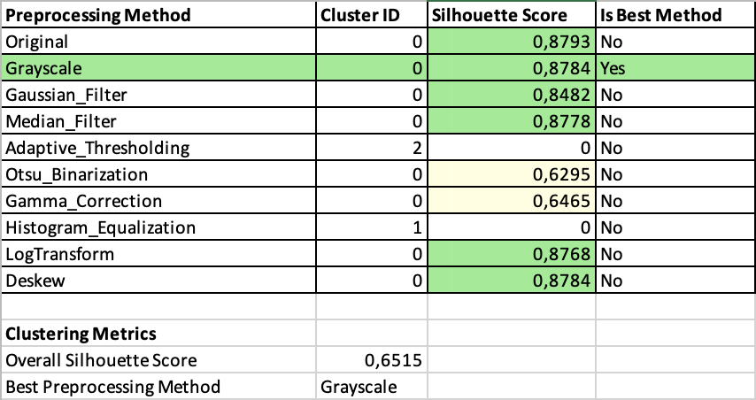
6. Performance and Analysis
Figure. 6.5: Cluster Distribution of word embeddings
The cluster analysis using the K-means algorithm offers a detailed view of the variation in structural properties of the vectors derived from the text. In this example, two clusters indicate a significant difference between two texts, which is visually represented in the scatterplot, where one method stands apart while the others cluster together in the same region.

Slide 18
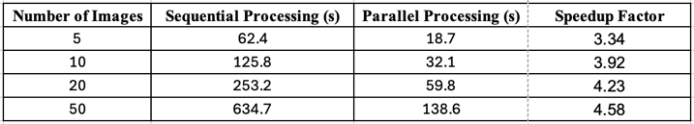
6. Performance and Analysis
Figure. 6.5: Cluster Distribution of word embeddings
The results show that parallel processing provides greater efficiency as the number of images increases, with a speedup factor of nearly 4.5× for larger datasets. This efficiency gain is attributed to the concurrent processing model implemented in the OcrProcessor class, which effectively utilizes multiple CPU cores.

Slide 19


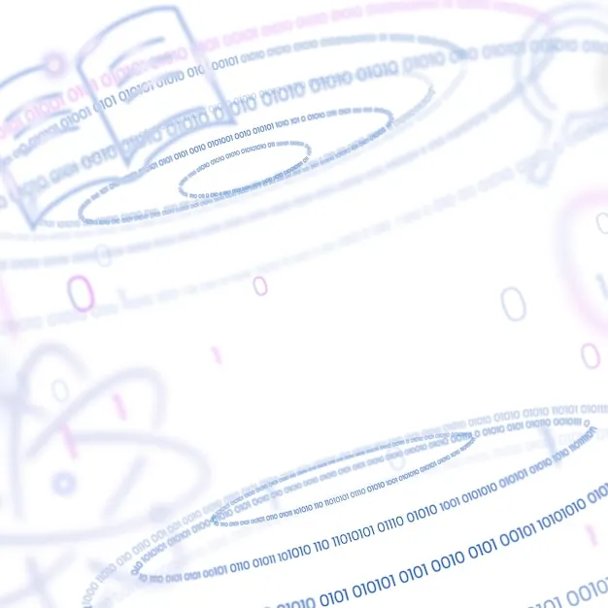
7. Testing and Visualisation
Command Line Interface
(app run on a terminal)
Graphical User Interface
(app run with graphic interface)
Unit Test Screen

Slide 20
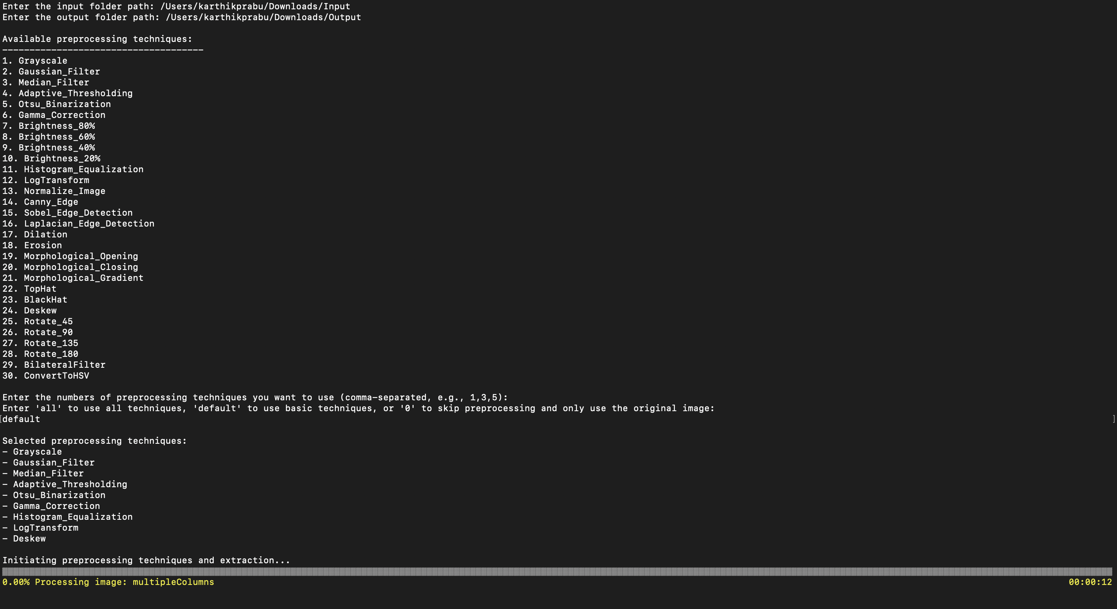
7. Input in CLI Interface
Figure. 7.1: User Input Preprocessing methods
User is provided with options to select the
Input folder
Output folder
Preprocessing method from the available list
A progress bar is displayed on the screen to know the status of the processing with the elapsed duration.

Slide 21
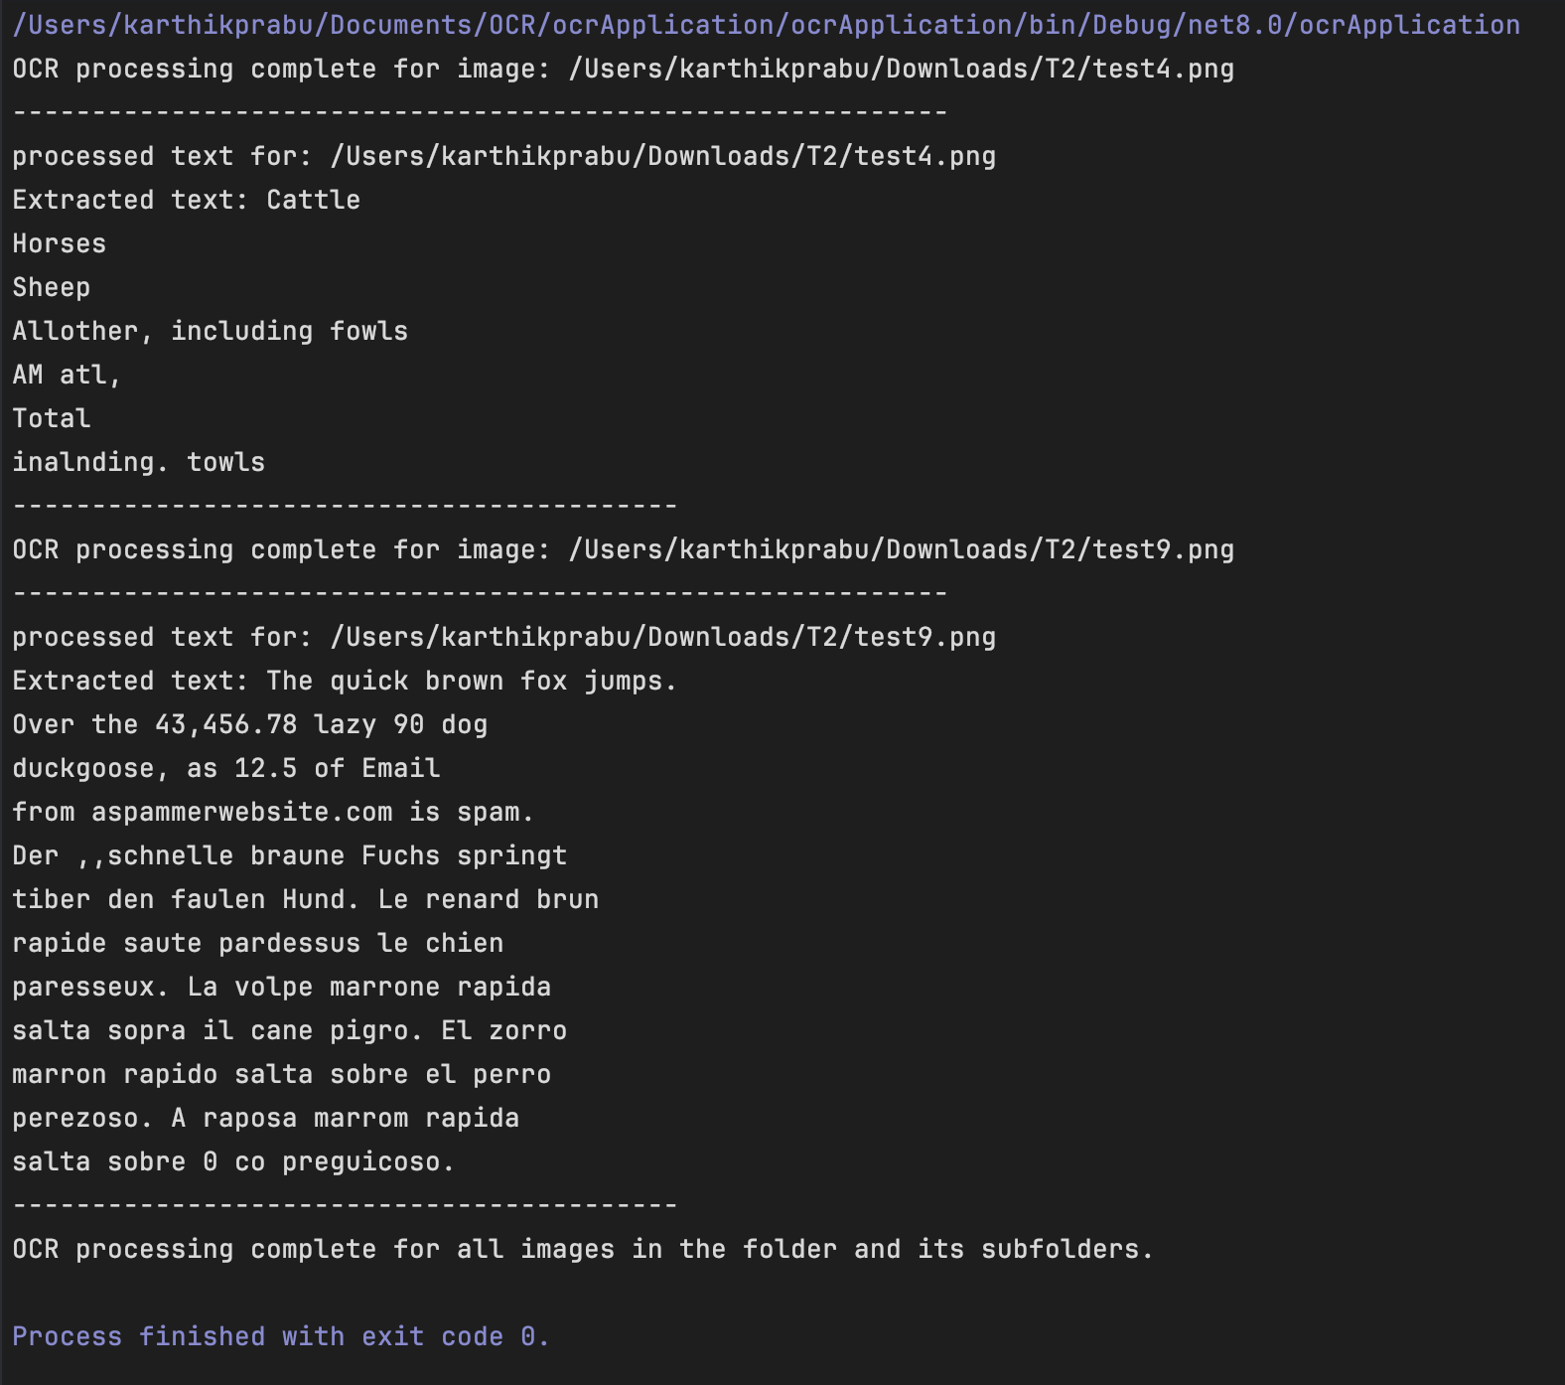
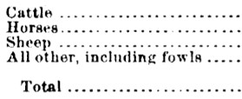
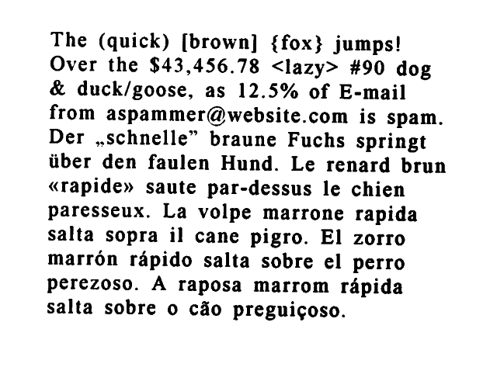
7. Output of Extracted Text in CLI
Figure. 7.3: Input Image 1
Figure. 7.4: Input Image 2
Figure. 7.2: The extracted text from the image with best preprocessing method

Slide 22
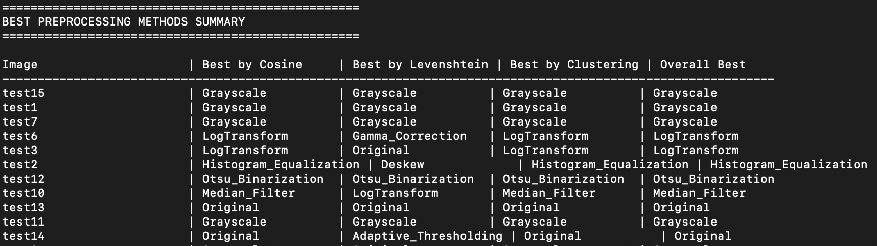
7. Displaying Summary in CLI
Figure. 7.5: Summary in CLI

Slide 23
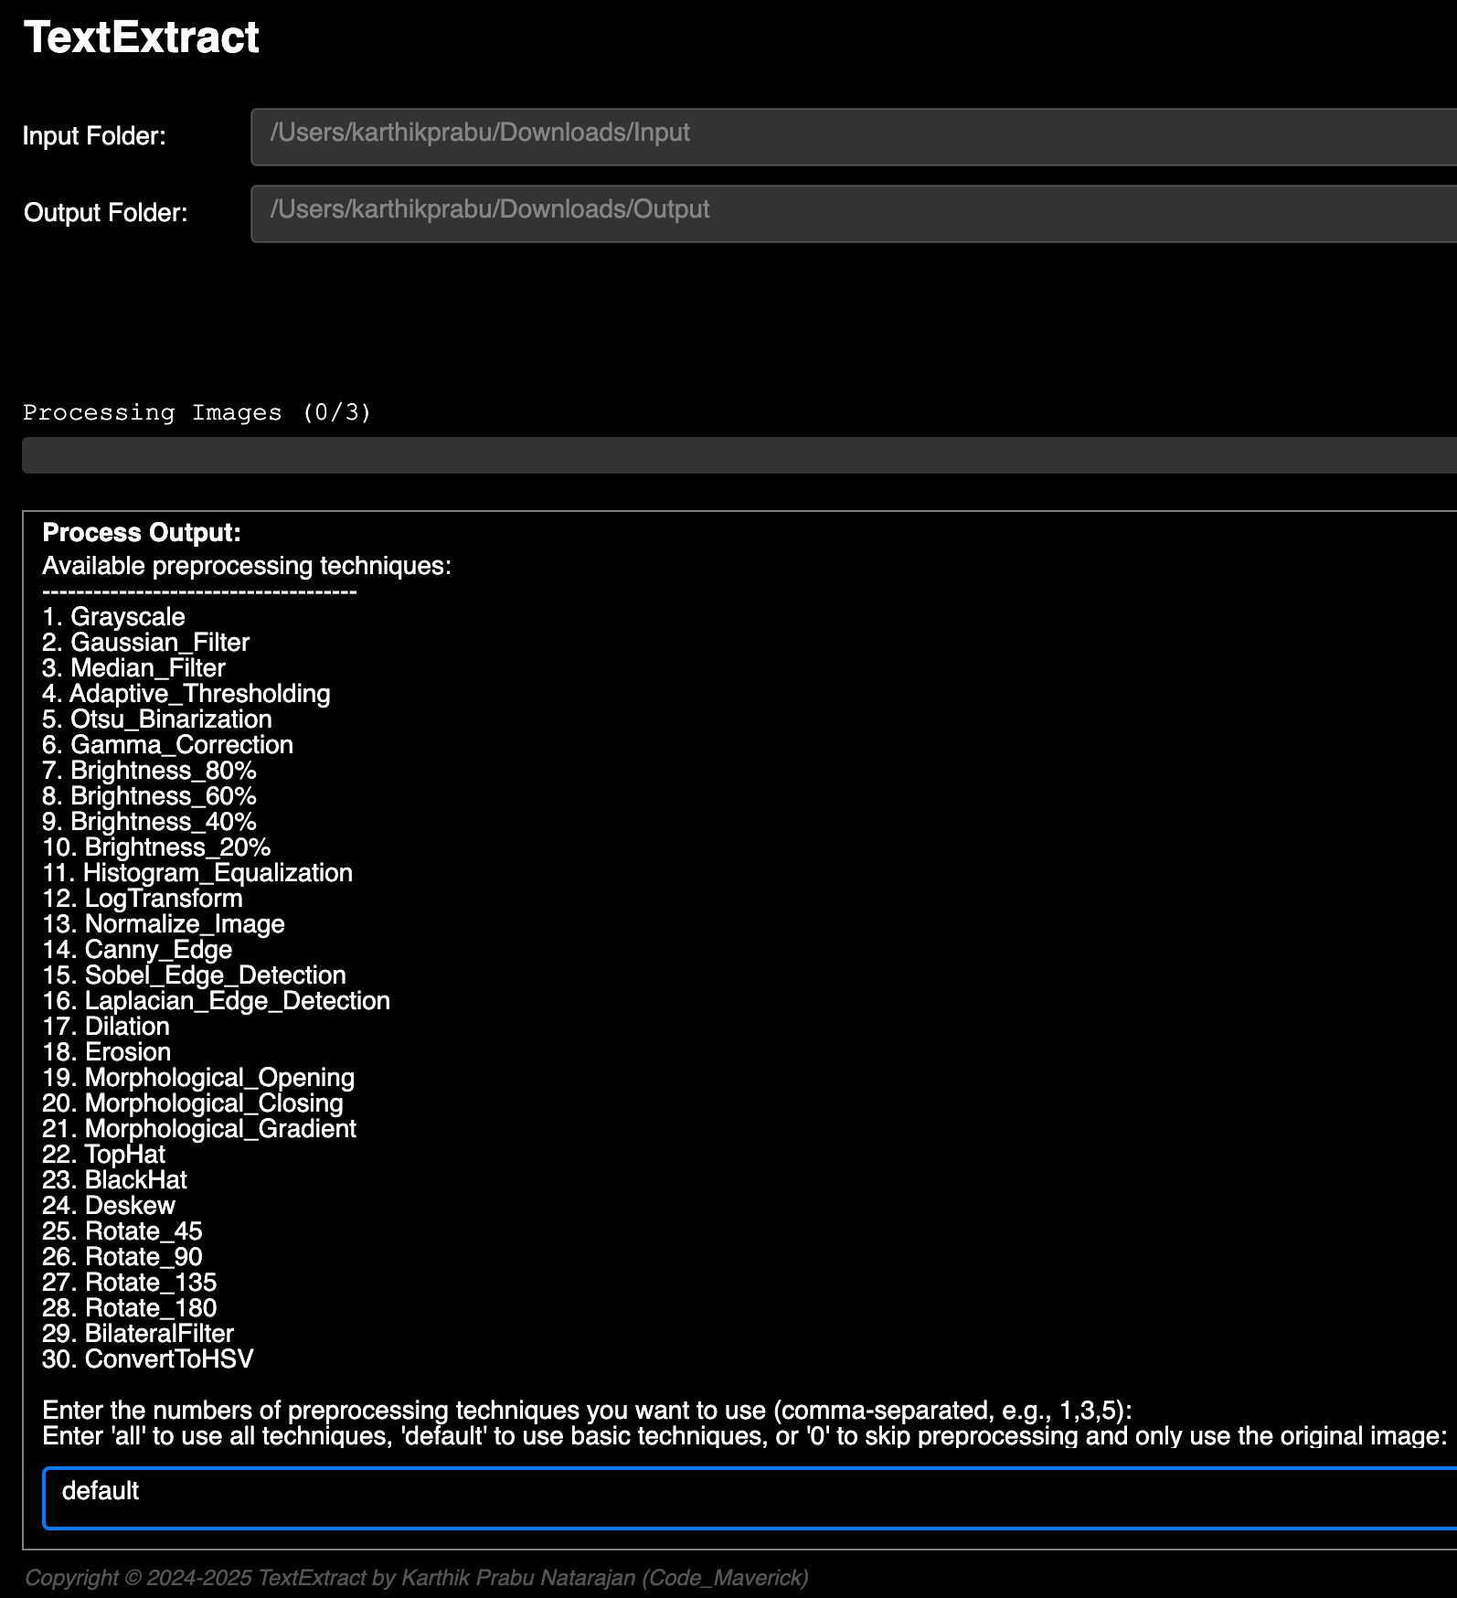
User is provided with options to select the
Input folder
Output folder
Preprocessing method from the available list
7. Input in GUI Screen
Figure. 7.6: User Input Preprocessing methods

Slide 24
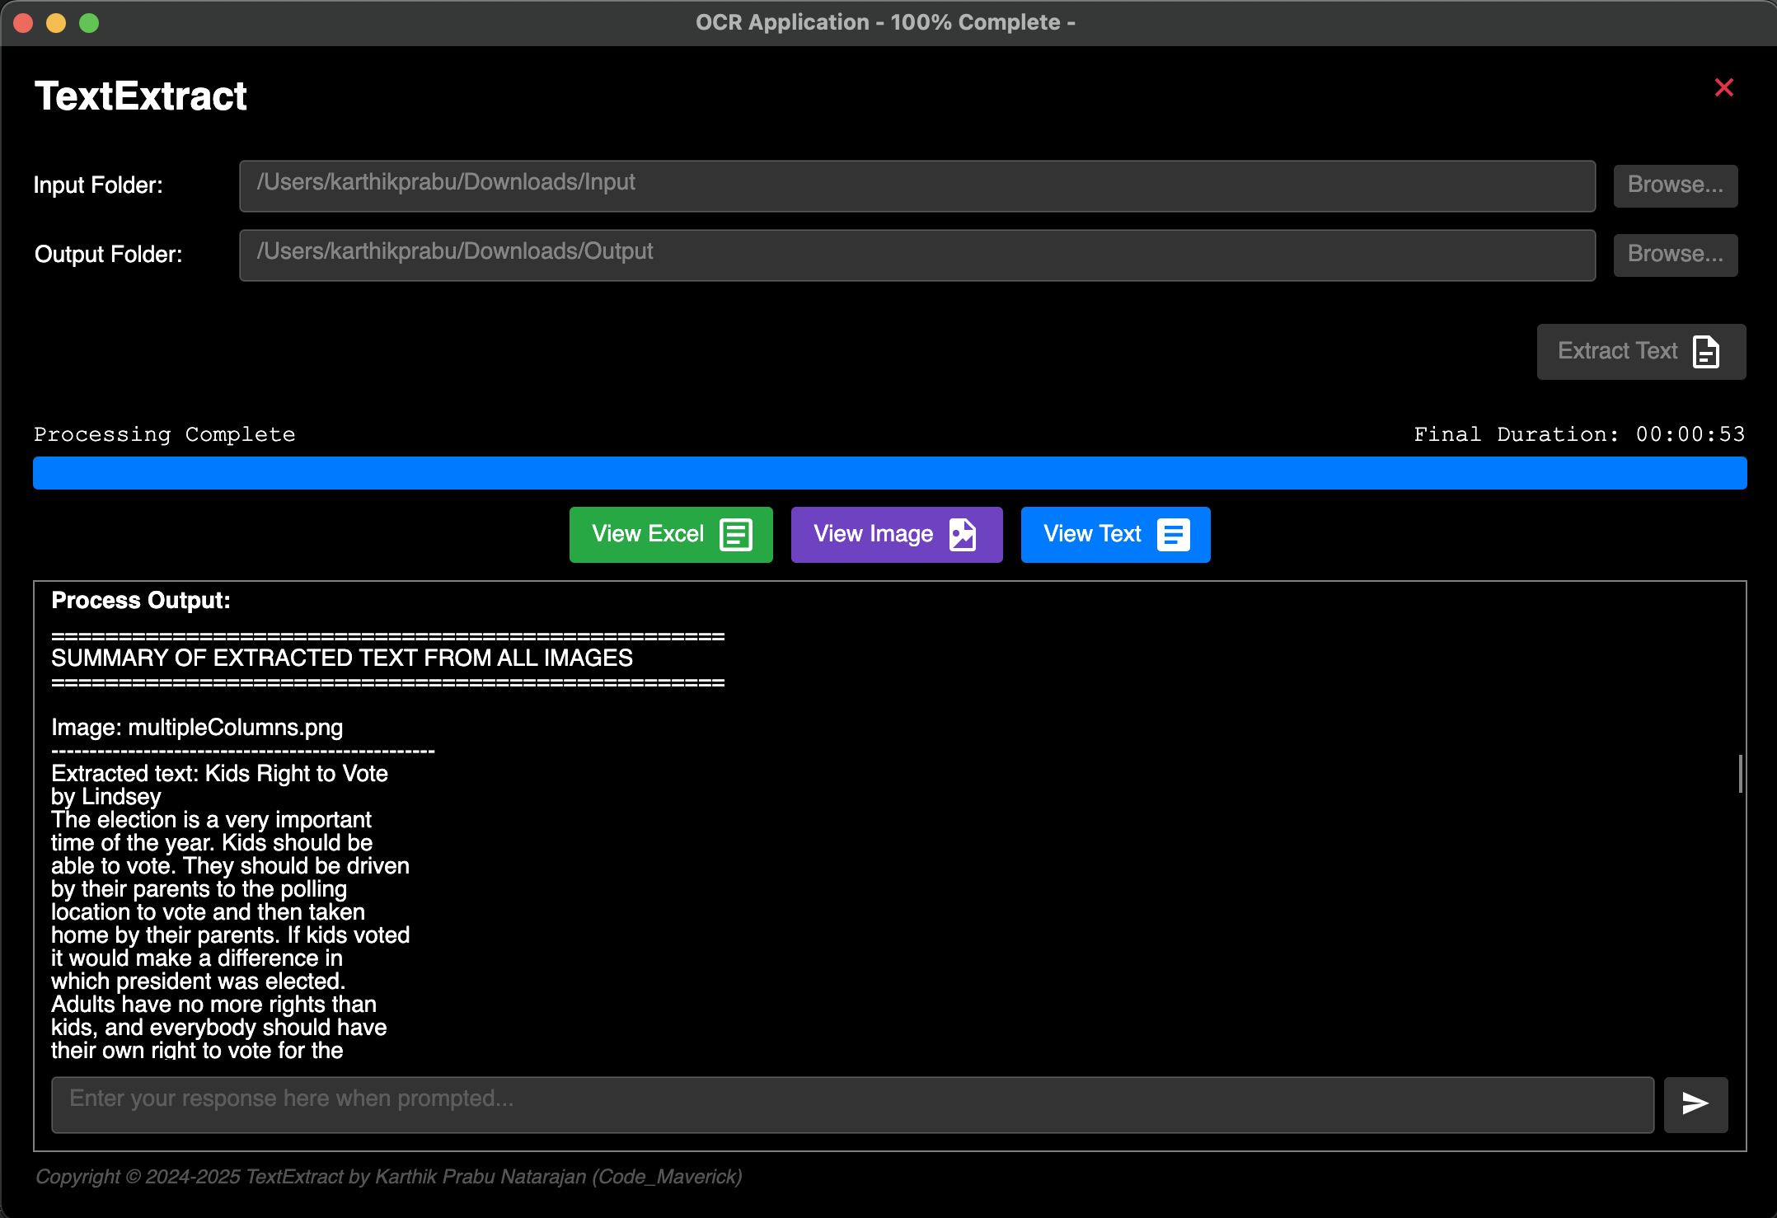
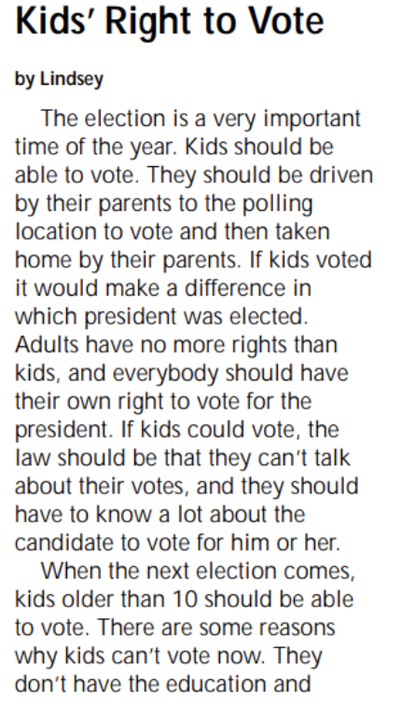
7. Output of Extracted Text in GUI
There is an option on the graphical interface to navigate and open the generated files from the application
Figure. 7.8: Gui Output
Figure. 7.7: Input Image 3

Slide 25
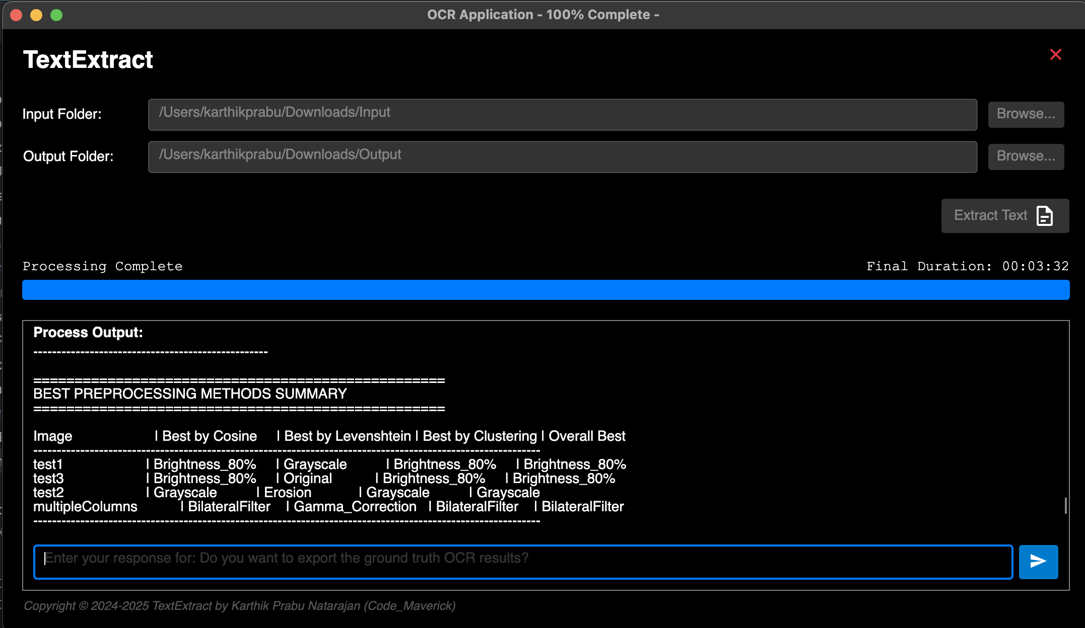
7. Displaying Summary in GUI
The user is displayed with the comprehensive analysis of the preprocessing summary
Figure. 7.9: Summary in GUI

Slide 26
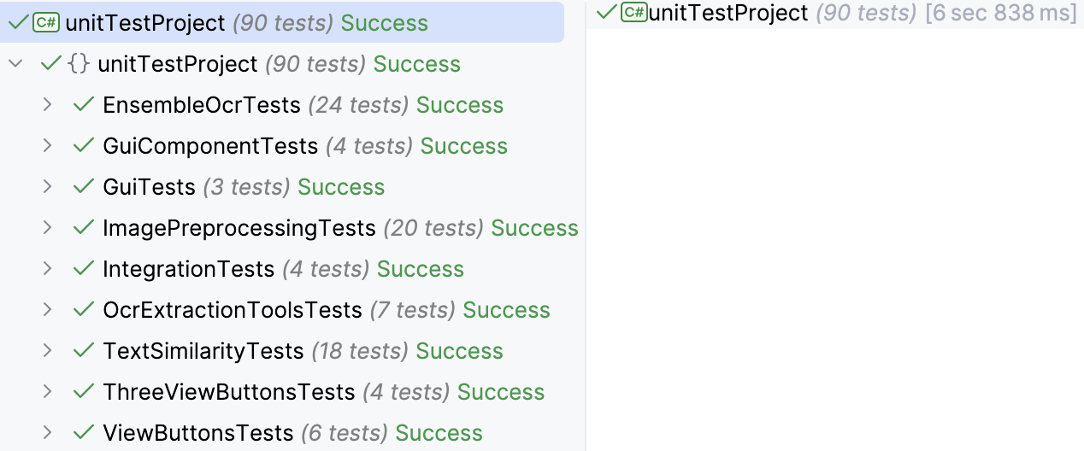
7. Unit Test Results
Figure. 7.10: Unit Testing Of The OCR Application
Unit tests have been integrated to address specific scenarios. During the application’s testing phase, no instances of test failures have been identified.

Slide 27
8. Conclusion
Developed a versatile prototype to compare various image preprocessing techniques and select the best method.
Integrated with the LLAVA LLM for seamless data stream processing and efficient ensemble outcomes.
Incorporated cosine similarity and clustering functions to differentiate between preprocessing methods and select the most accurate model for each image.
Ensured robustness by consistently identifying the optimal preprocessing technique for different images.
Implemented comprehensive unit tests, including edge cases, to guarantee accuracy and reliability.
Highlighted the system's strength in comparing and optimizing preprocessing techniques for bulk image datasets.

Slide 28
9. Future Work
The project acknowledges certain limitations, particularly in its initial scope focused on meeting specific project requirements. The future work for this project includes several key areas for improvement and expansion. These efforts aim to optimize the OCR solution, enhance scalability, and provide a more efficient user experience. The proposed future work includes:
Optimize OCR performance by refining image preprocessing techniques and exploring advanced algorithms to improve text extraction accuracy.
Enhance application scalability and responsiveness to efficiently handle larger datasets and diverse image types.
Extend compatibility with additional platforms to broaden the application's usability.
Integrate machine learning models for adaptive preprocessing to improve accuracy and adaptability.
Deploy the application on a server to reduce the load on user systems and provide a more efficient user experience.
Improve overall versatility, accuracy, and robustness for real-world OCR tasks, pushing the boundaries of image processing capabilities.

Slide 29
Interactive Demo
Load Image: Upload document image for OCR processing
Select Preprocessing: Choose from available preprocessing methods
Process Image: Extract text using selected OCR engine
View Results: Compare OCR output with synthetic ground truth
Analyse Similarity: Calculate and visualize similarity metrics
Export Results: Generate Excel-based report with visualizations
A Demo video has been uploaded. Please Find the link here

Slide 30

Thank You

